Slide 1
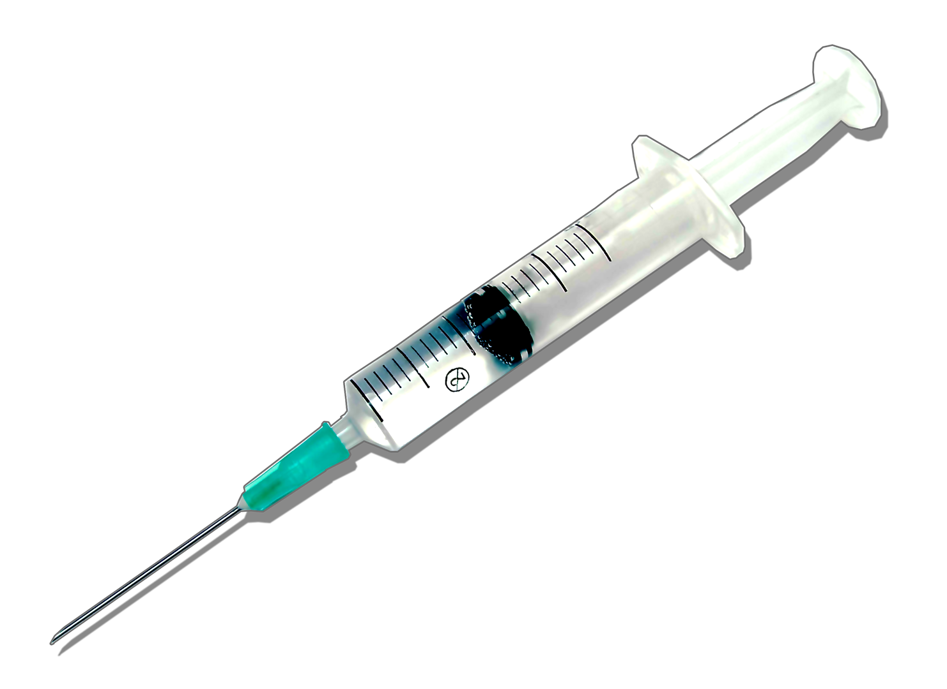

Hypodermic Needle Syringe
Prof. Sajan Kapil
Department of Mechanical Engineering
Akshar Chauhan
220103006
Indian Institute of Technology Guwahati

Slide 2
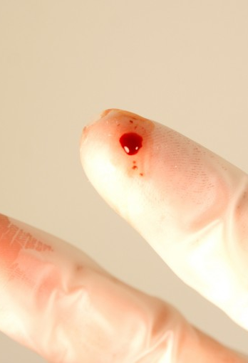
Needle stick injuries occur when the skin is accidentally punctured by a sharp object, such as a hypodermic needle that has come into contact with blood, tissue, or other bodily fluids. Here's a breakdown of the key points:
We need to redesign the syringe cap to prevent needle stick injuries, which affect thousands of healthcare providers and others every year.
PROBLEM STATEMENT
Cause: Accidental puncture by a syringe, most commonly a used hypodermic needle.
High-risk professions: Healthcare workers such as nurses, doctors, lab technicians, and anyone who regularly handles needles are at an increased risk.
Transmission risk: These injuries can potentially transmit blood-borne diseases such as:
Hepatitis B (HBV) Hepatitis C (HCV) Human Immunodeficiency Virus (HIV) - the virus that causes AIDS

Slide 3
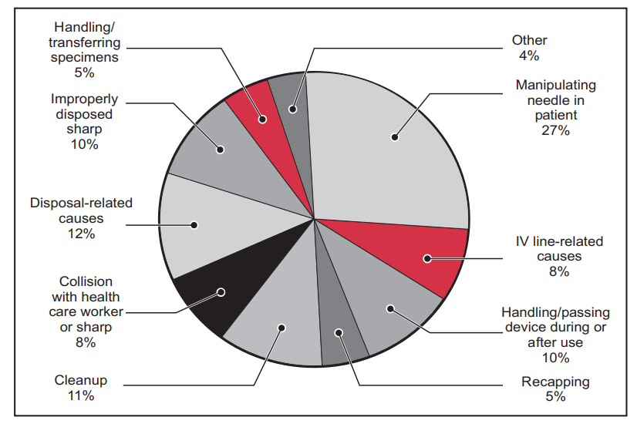
Motivation and Application
Needle stick injuries
Needlestick injuries pose a significant risk of exposure to serious and fatal diseases for healthcare workers.
There is a greater need to adapt to new things in today's rapidly growing world. We must identify shortcomings in older methods and develop modified ones so that we can all live a healthy life.
Therefore, we have developed a different design for our hypodermic syringe caps, incorporating a slider crank mechanism.
Its application is mainly in syringes as of now, but the idea can be applied to other sectors where needle coverage is required.
"Data containing the causes and types of needle stick injuries affecting people."
Most injuries stem from the cap design, as cautious handling often results in accidents. To evolve in line with our advancing world, we must leverage our knowledge to implement necessary changes.

Slide 4
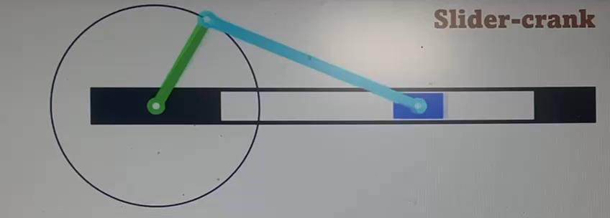
LITERATURE REVIEW
The slider-crank mechanism is a simple but versatile mechanical linkage that converts rotational motion into linear motion, or vice versa. It consists of three main components: a crank, a connecting rod, and a slider.
The crank is a rotating shaft driven by a motor or another power source.
The connecting rod is a linear link that connects the crank to the slider.
The slider is a sliding element that moves back and forth along a straight line.
Video
When the crank rotates, it pushes and pulls the connecting rod, causing the slider to move back and forth along a straight track. Additionally, you can reverse the action: by pushing or pulling the slider, you can rotate the crank.

Slide 5
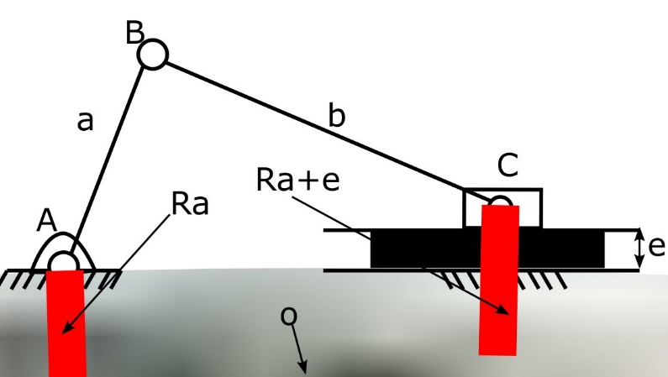
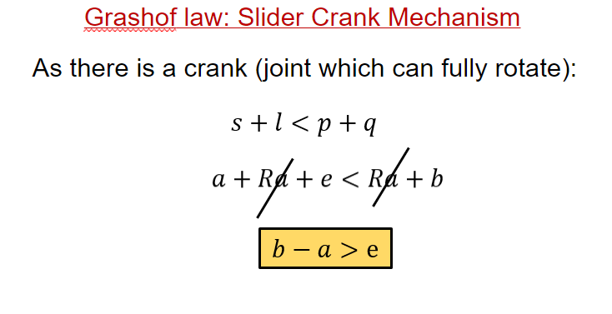
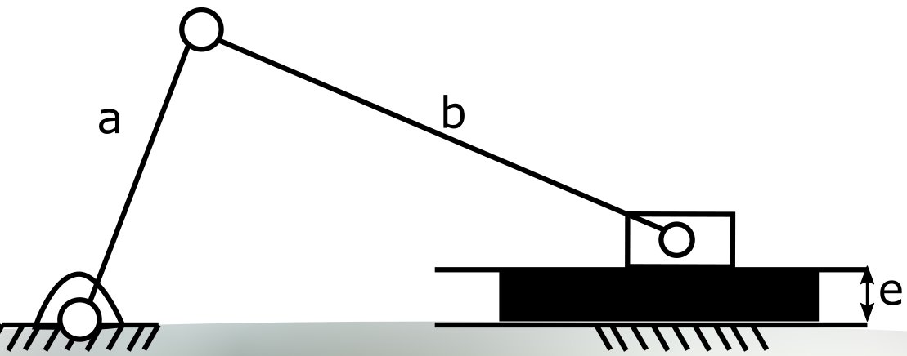
Kinematic Analysis
No. of links, n=4
No. of lower pairs, p1=4
No. of higher pairs, p2=0
DOF = 3(N-1) - 2P1 - P2
= 3(4-1) - 2*4 - 0
= 9 – 8 = 1
Thus, the degree of freedom of this mechanism is 1.
“Dimensions are mentioned in the cad file.”

Slide 6
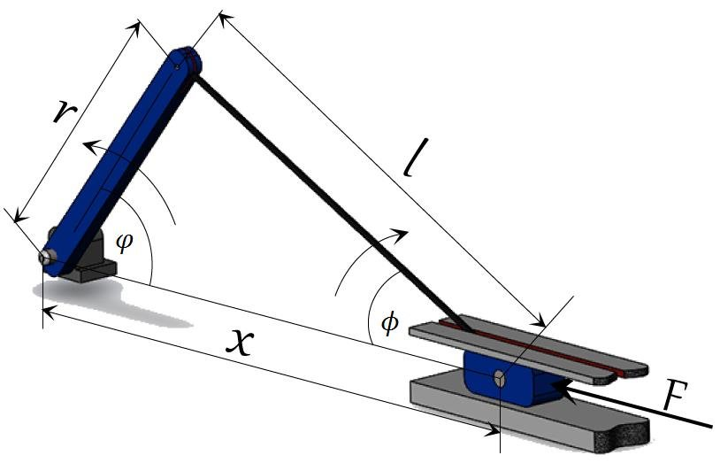
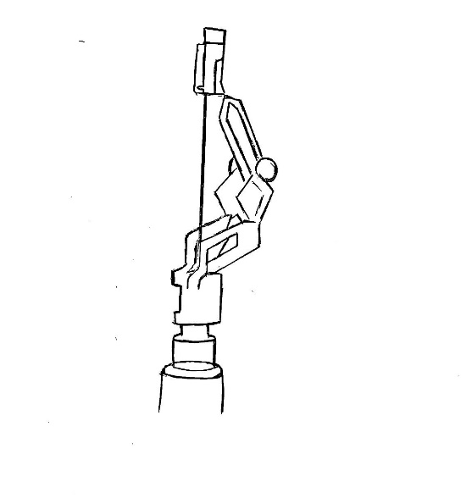
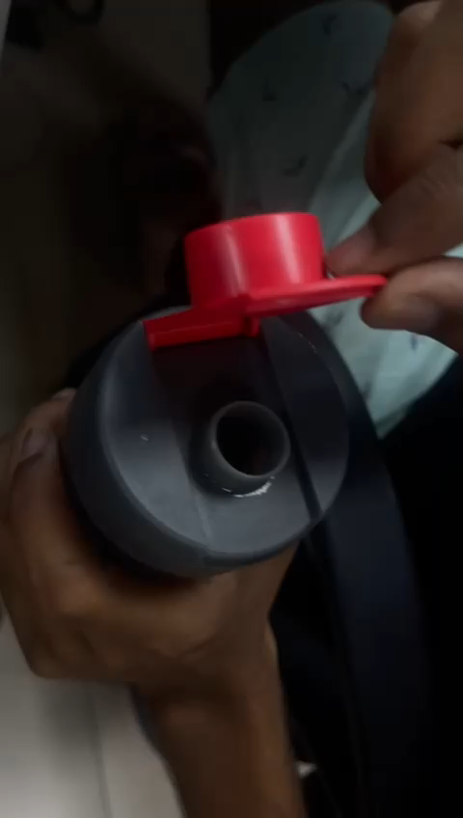
P
Crank
Connecting rod
At point P, we will use a locking mechanism. This means that when the crank and the connecting rod are in line, the motion is further restricted and it locks there until enough pressure is applied to rock it backwards again. This can be achieved by using mechanical stops, which are typically positioned strategically within the mechanism to limit the range of motion of specific components.
Video
The extrusion locks and prevents further motion.

Slide 7
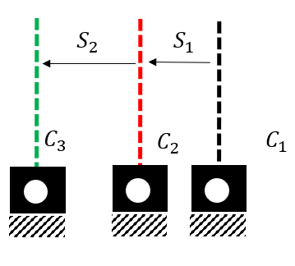
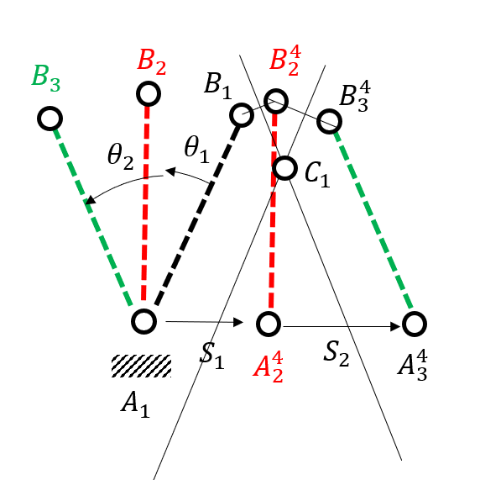
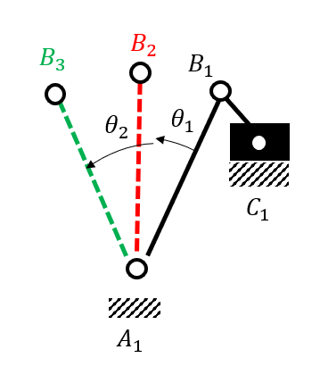
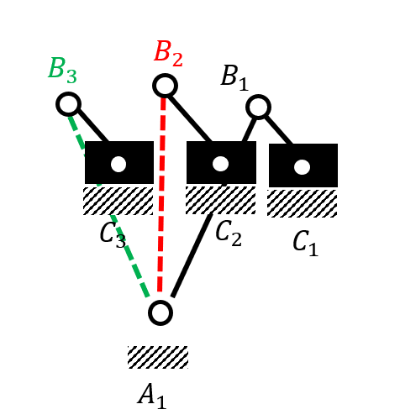
Kinematic Synthesis
Kinematic synthesis of slider crank mechanism
with crank as the input

Slide 8
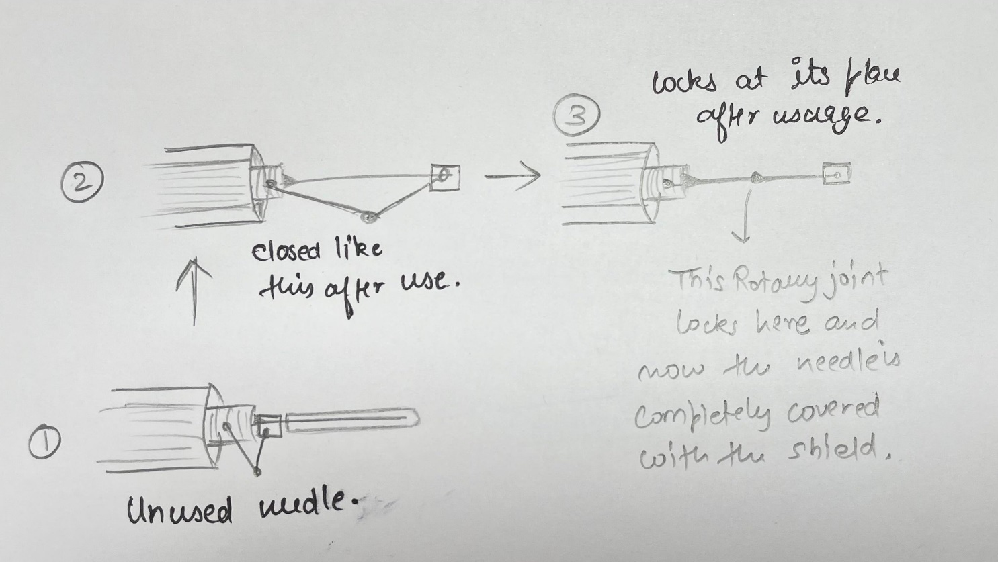
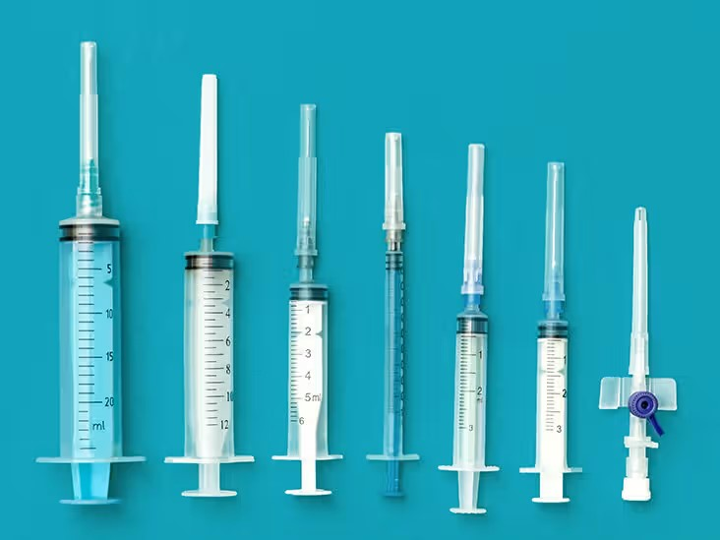
Strategy
We are planning to enhance the needle cap design by incorporating a safety feature. Once capped, a locking mechanism will be used to secure the cap to the needle with a simple push of the thumb. A rotary joint will be utilized to lock the cap in place, ensuring that it does not come loose even if the needle breaks. The current design of the standard syringe cap is depicted below:

Slide 9
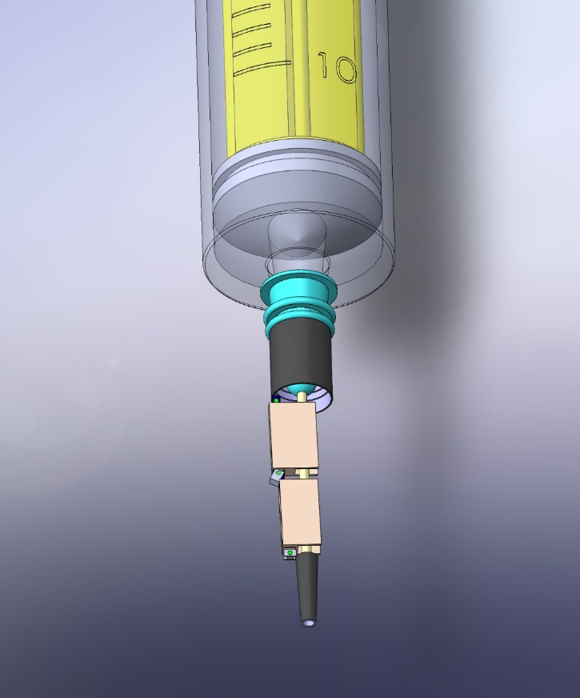
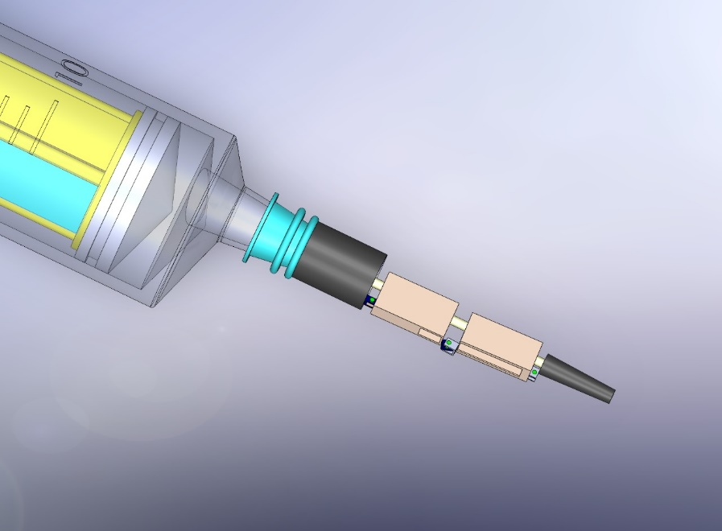
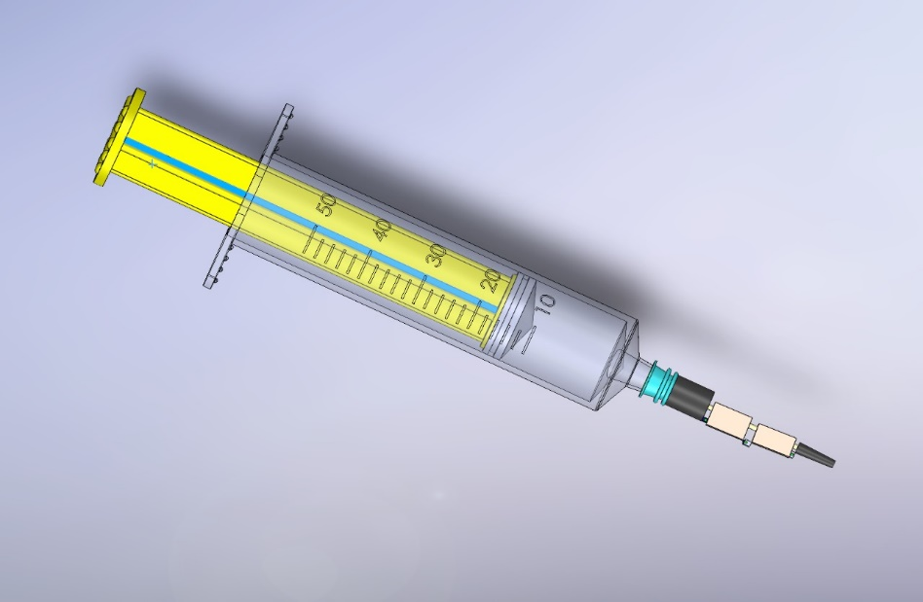
Computer Aided Design

Slide 10
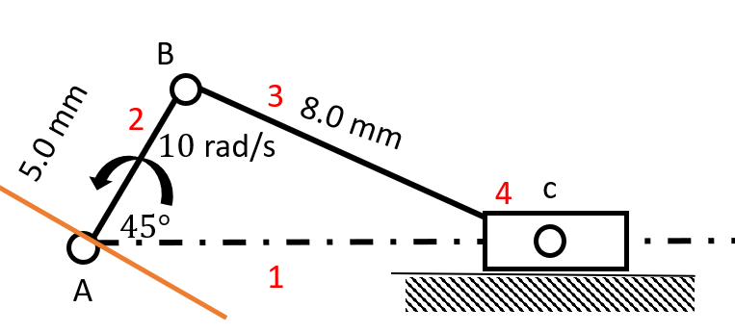
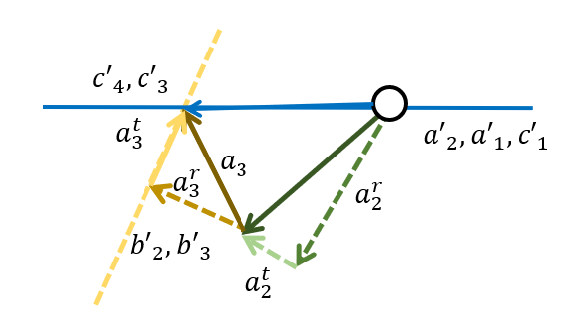
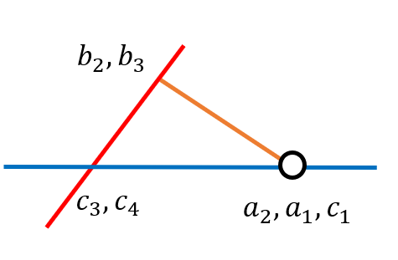
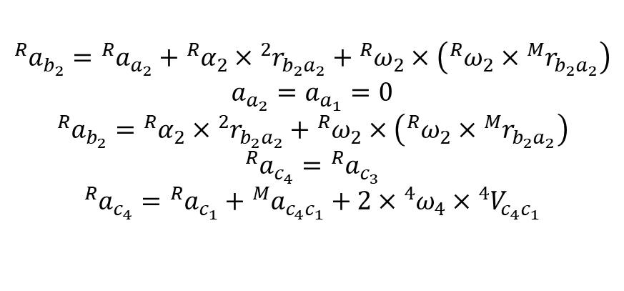





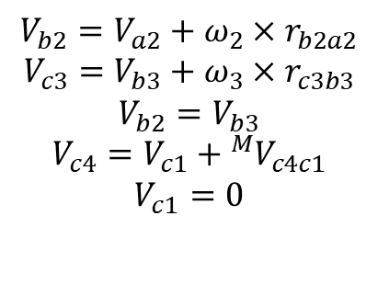

Motion Analysis
Velocity analysis:
Acceleration analysis:
$${}_{ }^{R}{a_{b_{2}}}={}_{ }^{R}{a_{a_{2}}}+{}_{ }^{R}{α_{2}}×{}_{ }^{2}{r_{b_{2}a_{2}}}+{}_{ }^{R}{ω_{2}}×\left({}_{ }^{R}{ω_{2}}×{}_{ }^{M}{r_{b_{2}a_{2}}}\right)$$
$$a_{a_{2}}=a_{a_{1}}=0$$
$${}_{ }^{R}{a_{b_{2}}}={}_{ }^{R}{α_{2}}×{}_{ }^{2}{r_{b_{2}a_{2}}}+{}_{ }^{R}{ω_{2}}×\left({}_{ }^{R}{ω_{2}}×{}_{ }^{M}{r_{b_{2}a_{2}}}\right)$$
$${}_{ }^{R}{a_{c_{4}}}={}_{ }^{R}{a_{c_{3}}}$$
$${}_{ }^{R}{a_{c_{4}}}={}_{ }^{R}{a_{c_{1}}}+{}_{ }^{M}{a_{c_{4}c_{1}}}+2×{}_{ }^{4}{ω_{4}}×{}_{ }^{4}{V_{c_{4}c_{1}}}$$
$$V_{b2}=V_{a2}+ω_{2}×r_{b2a2}$$
$$V_{c3}=V_{b3}+ω_{3}×r_{c3b3}$$
$$V_{b2}=V_{b3}$$
$$V_{c4}=V_{c1}+{}_{ }^{M}{V_{c4c1}}$$
$$V_{c1}=0$$

Slide 11
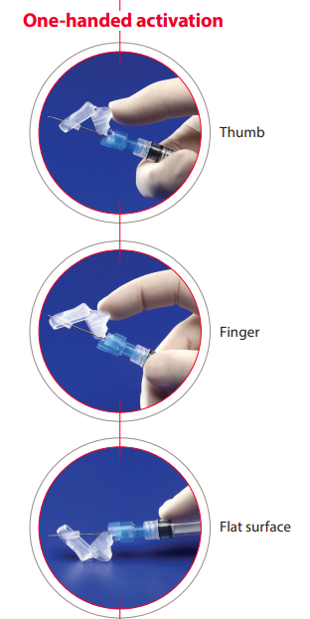

Fabrication Details
The plastic used in medical devices, such as Hypodermic Safety Needles, is typically medical-grade polypropylene (PP). Polypropylene is a widely used thermoplastic polymer in medical applications due to its excellent chemical resistance, durability, and biocompatibility. It is known for its low toxicity, high melting point, and ability to withstand sterilization processes such as autoclaving and ethylene oxide (EtO) sterilization. Medical-grade polypropylene is carefully formulated to meet strict regulatory requirements for safety and compatibility with biological tissues and fluids. This material is commonly used to construct needle hubs, safety mechanisms, and other components of hypodermic safety needles to ensure product safety, reliability, and performance in clinical settings.

Slide 12
Conclusions
The success of the Mechanism:
By using mechanical stops at sites and joints, we can successfully operate the mechanism.
Practicality:
This is a completely practical, simple yet very useful mechanism. It's easy to build and cost-effective. The material used is also not any DHP or rubber, providing better shielding and safety.
Contribution to the Society:
It will help save many healthcare workers as well as other people's lives. As we all now know how much of a danger needle stick injuries have been in the past and continue to be. This one simple change will bring much bigger changes in the medical sector.
"We can conclude that we don’t necessarily need to build complex machines and mechanisms to bring about change and solve problems. Even smaller, basic mechanisms, when applied smartly and thoughtfully, can advance technology and help save lives. As the saying goes, 'Make it simple but significant.'"

Slide 13
THANKYOU FOR YOUR KIND ATTENTION!

